Slide 1


1. To learn to talk about how often you do things with some adverbs of frequency: always / usually / often / sometimes / hardly ever / never / twice…
2. To listen for some specific information in conversations
3. To understand the conversation between Claire and Jack
4. To learn some new words and expressions

Slide 2


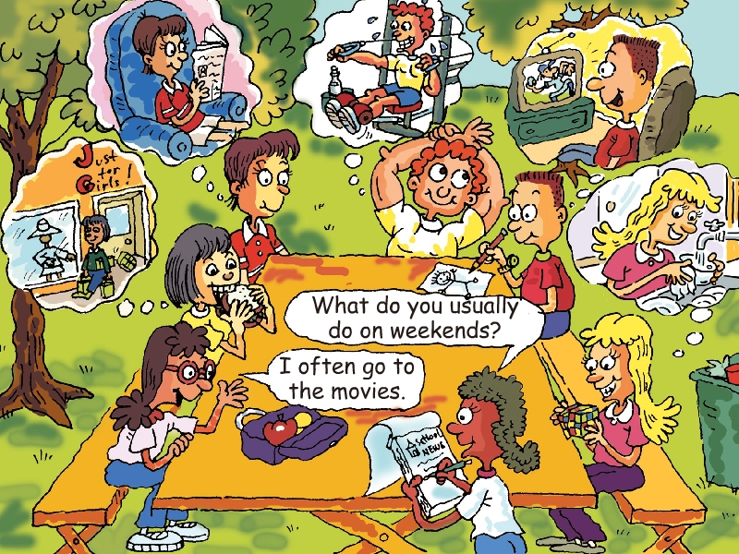

Look at the picture.
Talk about the weekend activities.
What do you usually do on weekends?
I often …

Slide 3

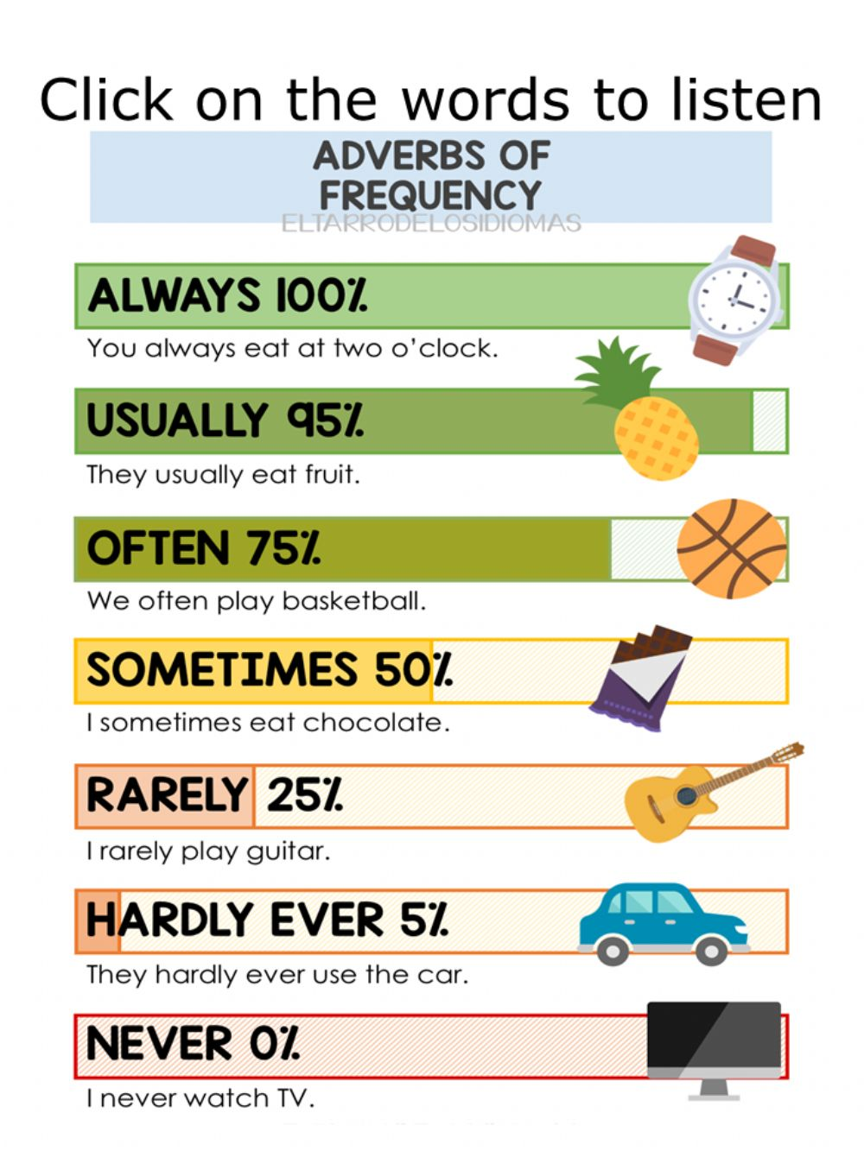
Adverbs of frequency
总是
通常
常常
有时
几乎不曾
从未
always
100%
0%
usually
often
sometimes
hardly ever
never

Slide 4

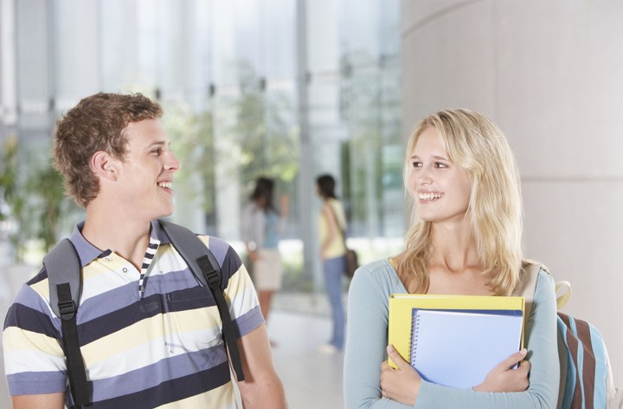
I often play soccer.
What do you do on weekends?
What does Alice do on weekends?
She often helps with housework.

Slide 5

Listen again and answer the questions.
1) What does the first girl sometimes do on weekends?
2) What does the first boy never do? What does he usually do?
3) What does the second boy always do?
4) What does the second girl often do?
5) What does the third girl hardly ever do? What does she love to do?
She sometimes goes shopping.
He never goes shopping. He usually watches TV.
He always exercises.
She often helps with housework.
She hardly ever watches TV. She loves to read.

Slide 6
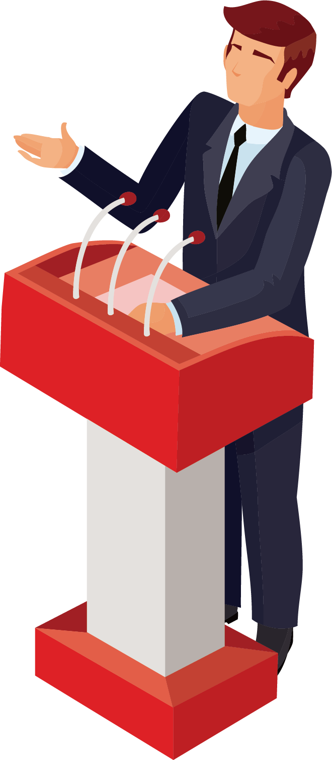
The first girl sometimes goes shopping on weekends and the first boy never goes shopping.
The second boy always exercises and the second girl often helps with housework.
The third girl hardly ever watches TV.
频度副词表示事情发生的频率，通常放在动词前面。

Slide 7

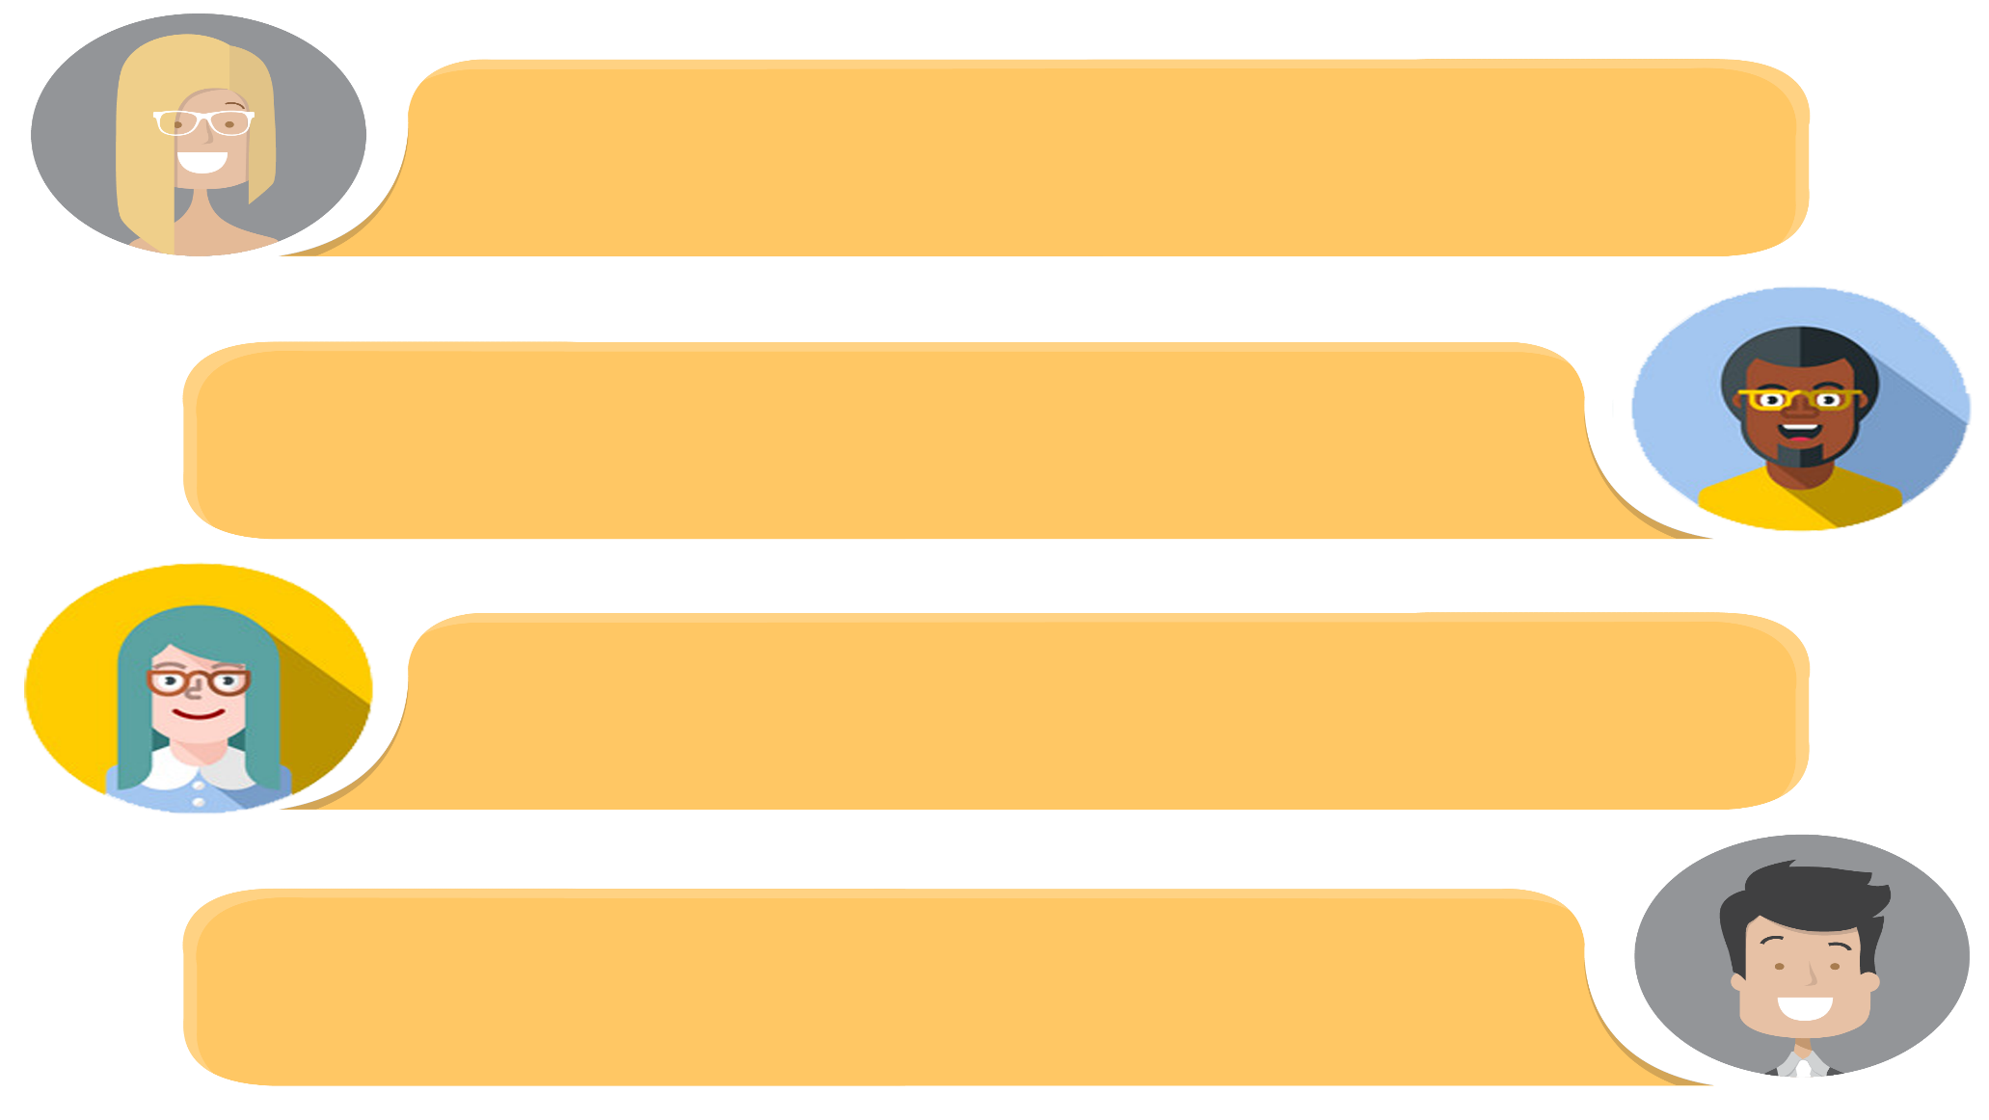
Practice the conversation in the picture above. Then make your own conversations about what you do on weekends.
What do you do on weekends?
I usually watch TV.
Do you go shopping?
No, I never go shopping.

Slide 8

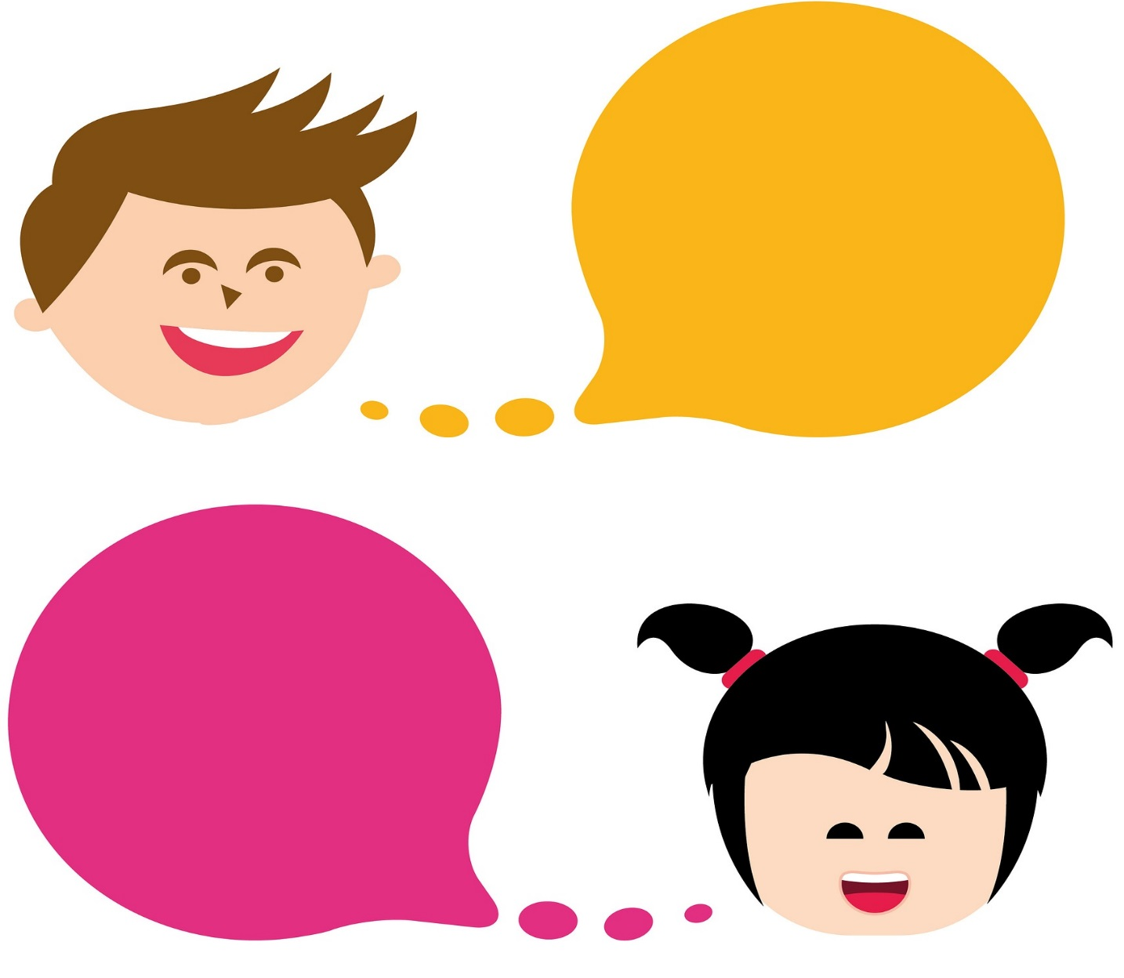
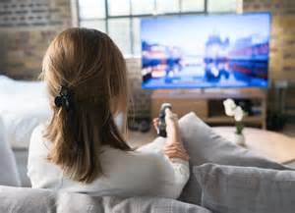
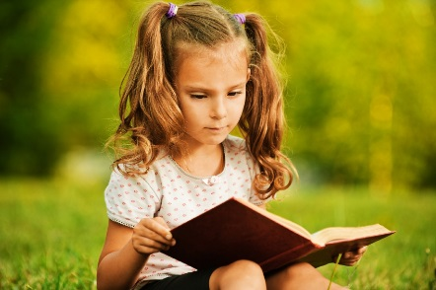
What do you do on weekends?
Do you…?
I ...
...

Slide 9

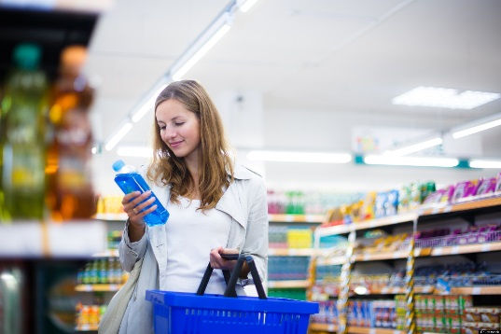
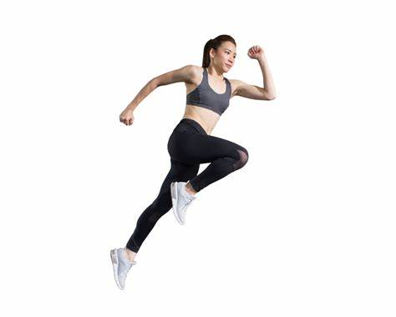
What does your sister do on weekends?
She …
Does she…?
....

Slide 10
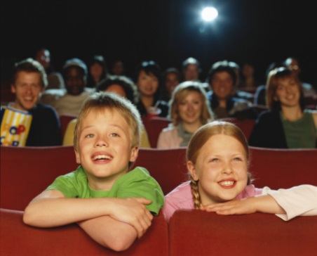
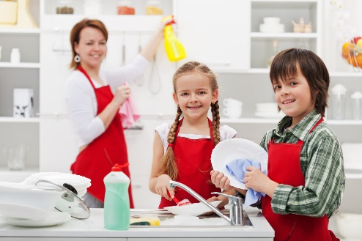
What do they do on weekends?
They…
Do they…?
....

Slide 11



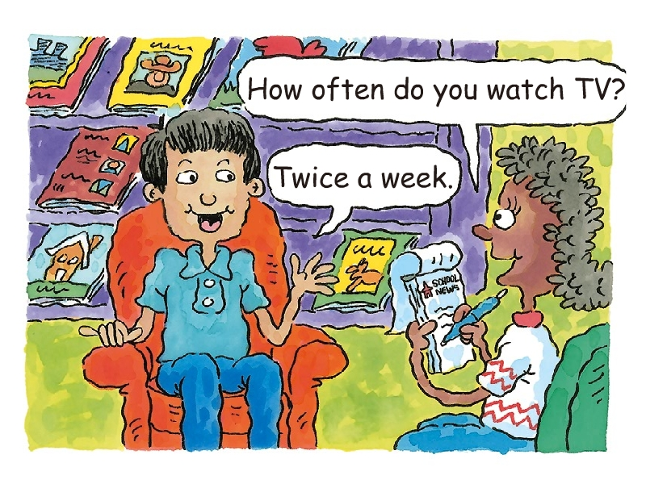
Cheng Tao is talking about how often he does these activities. Look at the picture and answer the questions.
1. What’s the boy’s name?
2. Is the person asking questions a man or a woman? What’s her job?
3. What question is the reporter asking?
4. What’s the boy’s answer?
5. What other activities does the boy do?

Slide 12
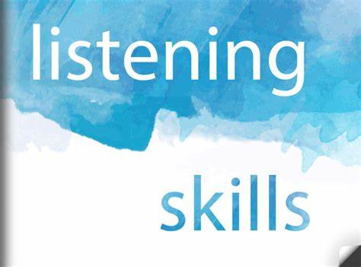
在听力过程中可以利用一些非听力因素来辅助理解，提高听力效率。
对图片、场景的观察和判断
利用听力活动中所给的文字线索
对主题人物身份的判断，预测他们的语言行为及语言内容

Slide 13


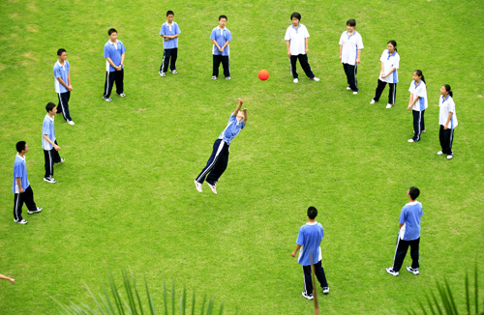
How often do you do these activities?
go to the movies
watch TV
go shopping
exercise
read
……

Slide 14
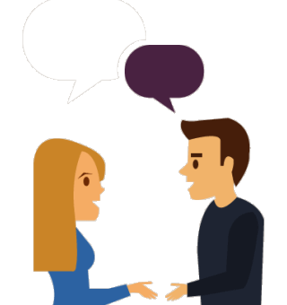
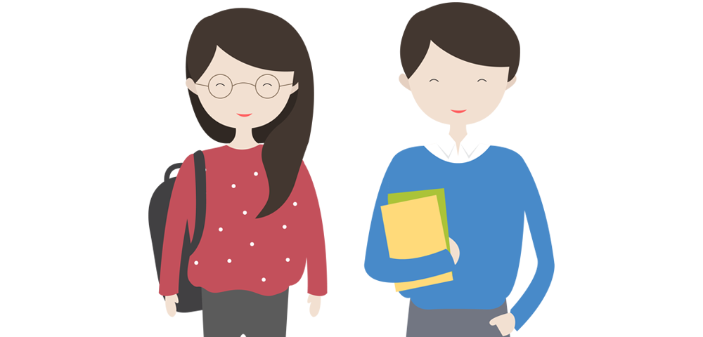
How often do you use the Internet?
I use the Internet …
What’s your favorite website (网站)?
…

Slide 15
How often do you read English books?
I read English books…
What’s your favorite book?
...
How often do you read it?
…

Slide 16

Read the conversation and answer the questions.
Is Claire free next week? Why?
What kind of dance is Claire learning?
What does Claire invite Jack to do? When can Jack join Claire for the activity?
No, she isn’t free. Because the next week is quite full for her.
She is learning swing dance.
She invites Jack to play tennis. Jack can join Claire on Tuesday.

Slide 17

A: How often does Cheng Tao watch TV?
B: He watches TV twice a week.
A: How often does Cheng Tao…?
B: He…
Ask and answer
Activities | How often
go to the movies | once a month
watch TV | twice a week
shop | twice a month
exercise | three times a week
read | every day

Slide 18

Unit 2

Slide 19
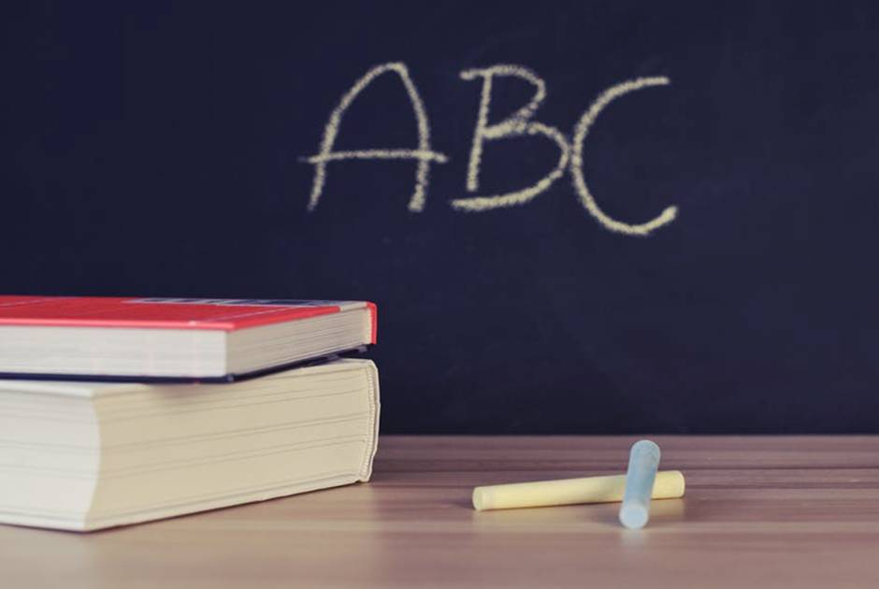


Slide 20


——What do you usually do on weekends?
——I usually...

Slide 21
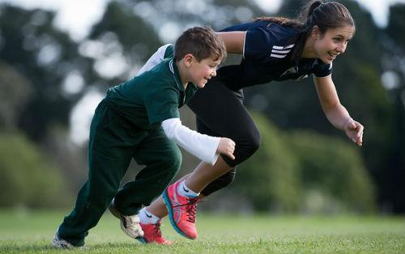
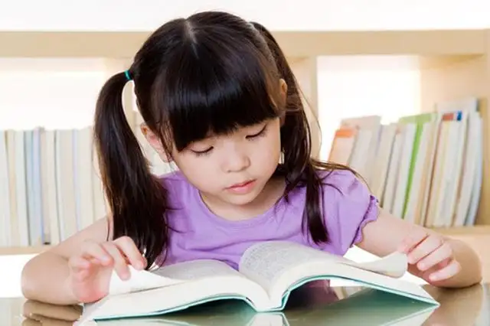
——What does she usually do on weekends?
——She often...
exercise
read (books)

Slide 22
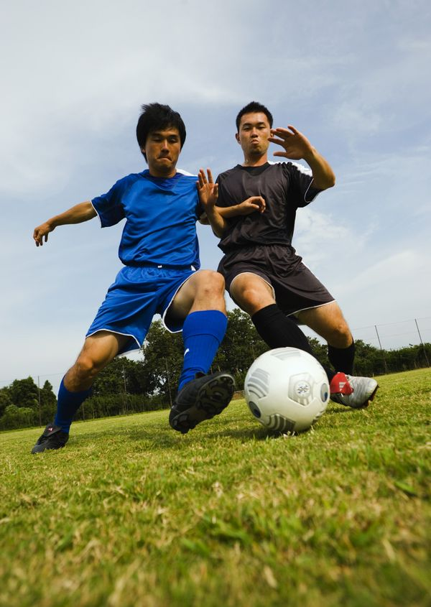
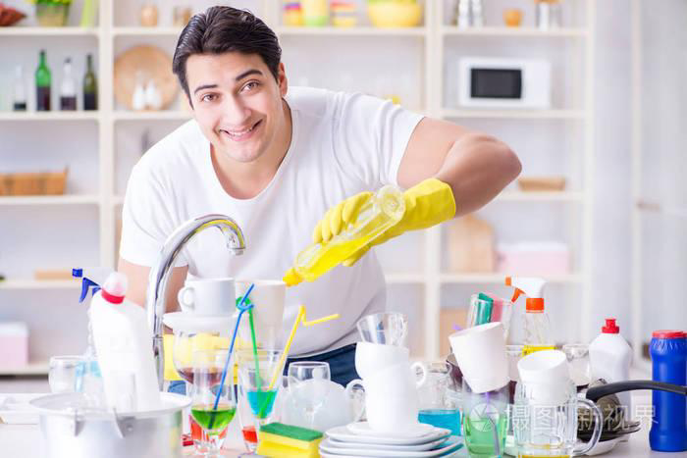
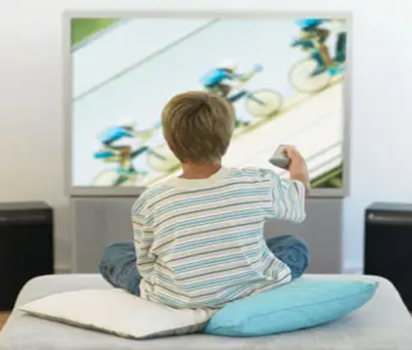
——What does he usually do on weekends?
——He often...
play football
help with housework
watch TV
un. 家务劳动;
家务事

Slide 23
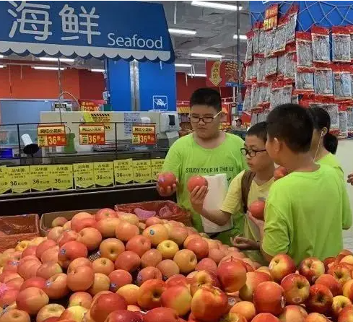
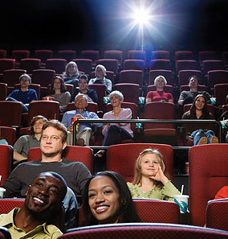
——What do they usually do on weekends?
——They often...
go shopping/shop
go to the movies

Slide 24
Look at the picture. Make a list of the weekend activities.
看图，列举更多周末活动。
1. _____________
_____________
2. _____________
3. _____________
4. _____________
5. _____________
help with housework
watch TV
exercise
read (a book)
go shopping

Slide 25
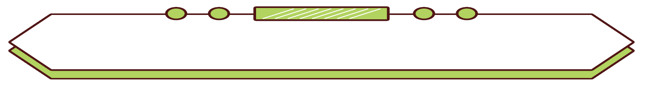
Do you know these words?
请根据发生频率的不同由高到低排列
adv. 几乎不
总是
通常
常常
有时
几乎从不
从未
100%
0%
hardly ever
adv. 在任何时候；从来；曾经
always
usually
sometimes
never
often

Slide 26
——How often does she ... ?
——...(含频率副词/频率副词词组)
how often 多久一次
用于提问频率的特殊疑问词组。
sometimes
once a week
read (books)
exercise
once 一次; twice 两次; 其他的次数表达 数字 + times

Slide 27
——How often do they ...?
——They ...
never
twice a week
go shopping/shop
go to the movies

Slide 28
——How often does he ... ?
——He ...
hardly ever
three times a week
every day
play football
help with housework
watch TV
频度副词表示事情发生的频率，通常放在动词前面。

Slide 29

Listen and write the activities next to the correct frequency words.
E.g. Someone always exercises.
1. always (100%) ___________________
2. usually ___________________
3. often ___________________
4. sometimes ___________________
5. hardly ever ___________________
6. never (0%) ____________________
exercise, read
watch TV
help with housework
go shopping
watch TV
go shopping

Slide 30

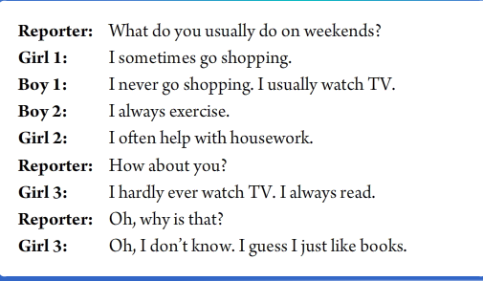
听力原文

Slide 31

Listen. Cheng Tao is talking about how often he does these activities. Number the activities [1-5] in the order you hear them.
Activities
a. _____ go to the movies
b. _____ watch TV
c. _____ shop
d. _____ exercise
e. _____ read
3
1
5
4
2

Slide 32


Listen again. Match the activities in 2a with how often Cheng Tao does them.
How often
every day
once a week
twice a week
three times a week
once a month
twice a month
Activities
a. go to the movies
b. watch TV
c. shop
d. exercise
e. read
about
about
maybe
about
——How often does Cheng Tao watch TV?
——About twice a week.

Slide 33
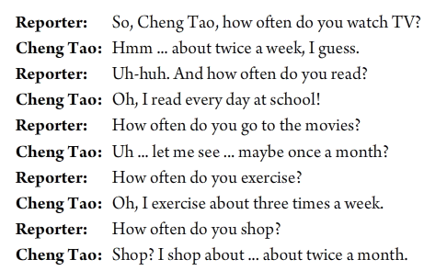
听力原文

Slide 34
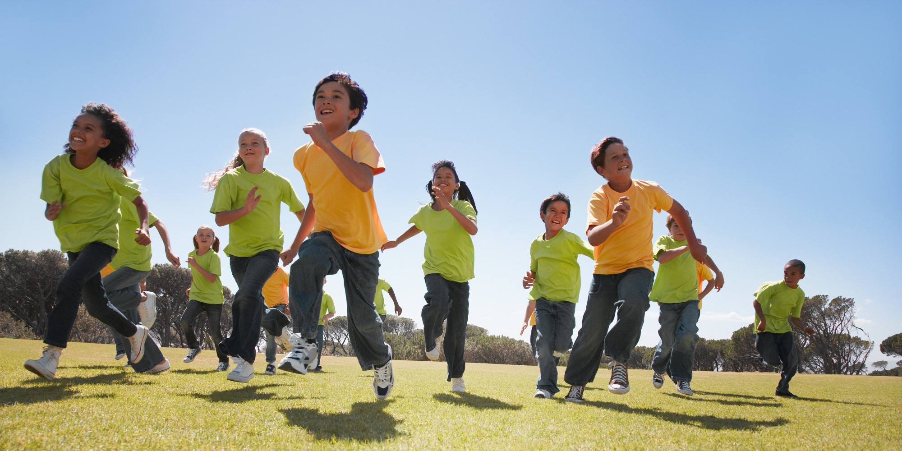
Unit 2
How often do you exercise?

Slide 35
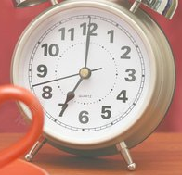
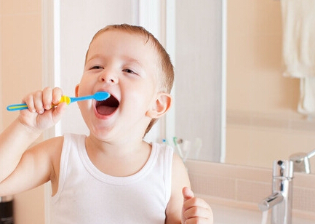
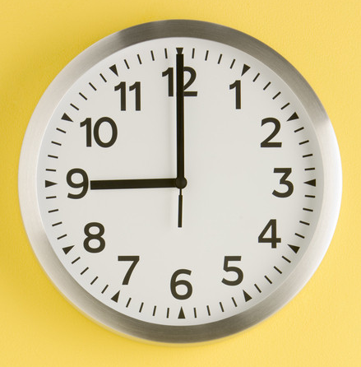
He brushes his teeth _____________.
twice a day

Slide 36
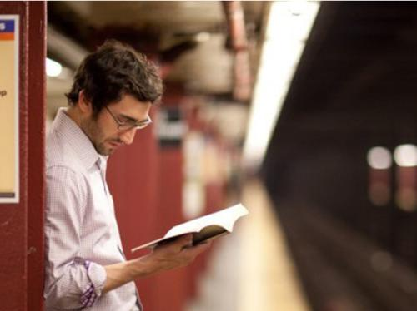
Reading Schedule
Sun. | Mon. | Tues. | Wed. | Thurs. | Fri. | Sat.
√ | √ | √ | √ | √ | √ | √
He reads books ___________.
every day

Slide 37
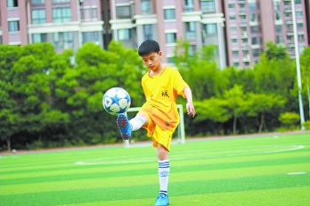
Exercise Schedule
Sun. | Mon. | Tues. | Wed. | Thurs. | Fri. | Sat.
football |  | running |  | running
He plays football _____________.
once a week
He runs ______________.
twice a week

Slide 38

Complete the following sentences.
1. 你通常在周末做什么？
______ ______ you ________ do on weekends?
我总是去运动。
I __________ __________.
2. 他们在周末做什么？
______ ______ they ______ on weekends?
他们经常帮助做家务。
They ________ help with _____________.
What do
usually
always exercise
What do
do
often
housework

Slide 39
3. 她在周末做什么？
What ________ she _________ on weekends?
她有时候去购物。
She __________ ________ __________.
does
do
sometimes goes shopping
4. 你多久看一次电影？
_______ _______ do you go to the ________?
我可能一个月去看一次。
I go to the movies maybe _______ _______ ________.
How often
movies
once a month
adv. 大概；或许；可能

Slide 40
5. 他多久看一次电视?
_______ _______ does he watch TV?
他几乎不看电视。
He _______ _______ watches TV.
How often
hardly ever
6. 你去购物吗？
_______ _______ go shopping?
不，我从不去购物。
No, I _______ _______ shopping.
Do you
never go

Slide 41

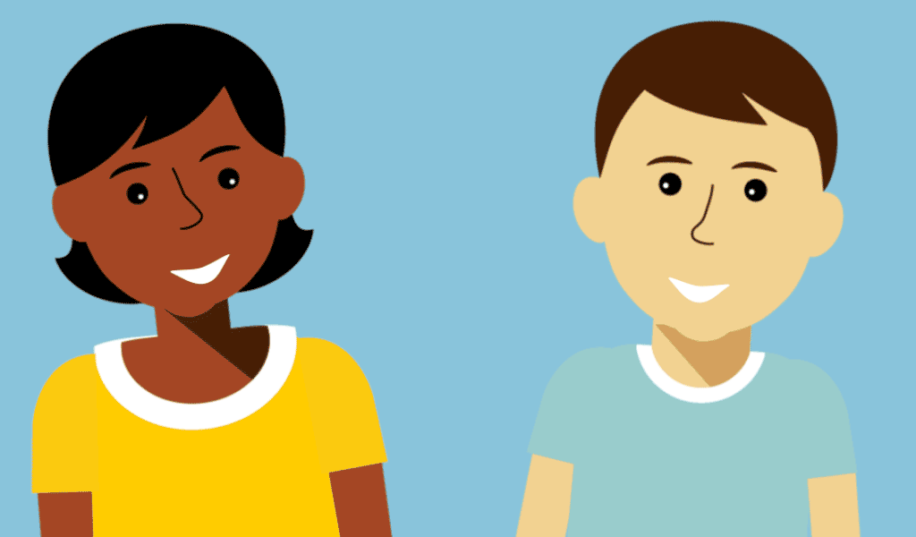
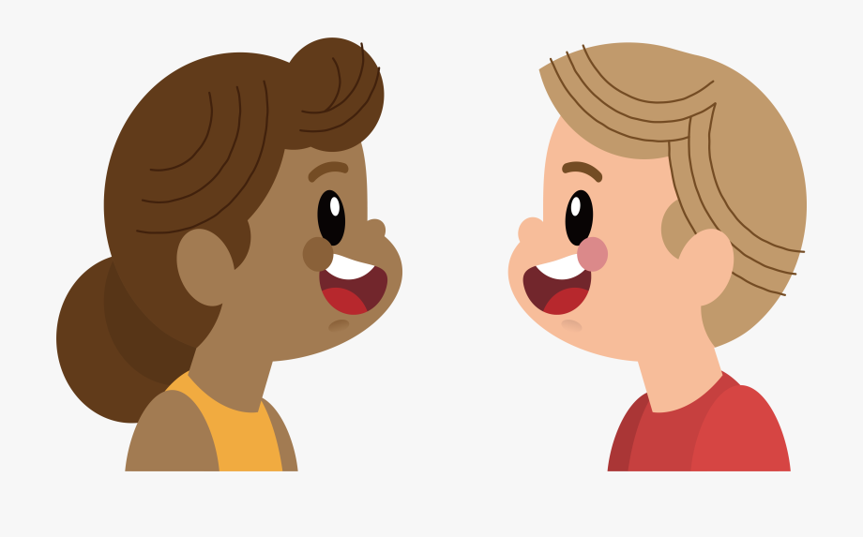
How often do you watch TV?
I watch TV every day.
n. 节目
What’s your favorite program?
Animal World.
How often do you watch it?
Twice a week.

Slide 42
How often does your partner do these activities? Ask and fill in the chart.
Activities | How often
watch TV
use the Internet
read English books
go to the movies
exercise
—How often do you ...?
—频率副词/
频率副词短语.
n. 互联网
every day
twice a week
four times a week
once a month
every day

Slide 43

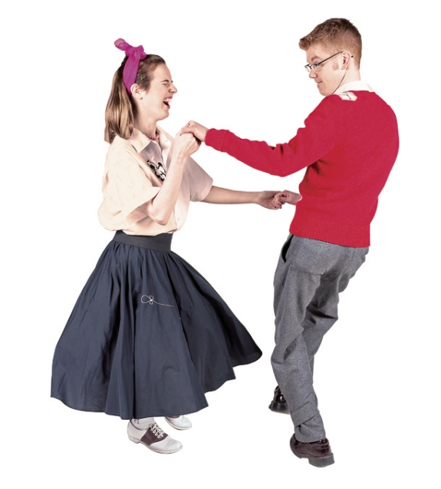
Look at the picture, read the conversation and answer the questions.
Who’s the girl?
She’s Claire.
2. Wha’s she doing?
She’s dancing./She’s having a dance lesson.
3. What kind of dance is it?
It’s swing dance.

Slide 44
Listen to the conversation and match the activities with the right time.
have dance lessons
on Wednesday and Friday
have piano lessons
on Tuesday
play tennis
every Monday

Slide 45
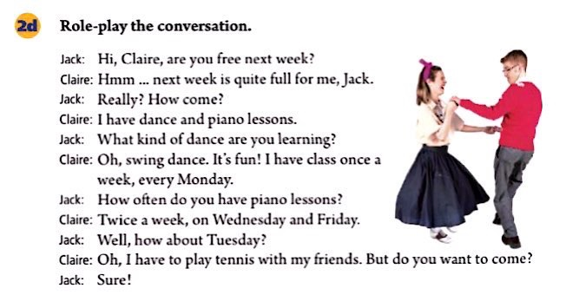
adj. 忙的；满的;
n. 摆动；秋千 v. 摆动；

Slide 46
Hmm … next week is quite full for me, Jack.嗯…我下周(已经安排得)很满了，杰克。
full adj. 忙的 同义词busy
满的 反义词empty be full of =be filled with 充满…的
饱的 反义词hungry
e.g. He had a full weekend.
他有一个忙碌的周末。
The restaurant is full every day.
这个餐厅每天都爆满。
I’m full, so I don’t want to eat anything.
我很饱了，所以我不想再吃什么了。
The bottle is full of water./The bottle is filled with water.
瓶子里装满了水。

Slide 47
How come? 为什么呢？/怎么会呢？
这是英语口语中的一个习语，既可独立使用，也可在其后接句子，用来询问事情的缘由或状况。
e.g. How come the sky is so blue today?
e.g. -- I didn’t even eat lunch today.
-- Really? How come?

Slide 48


在周末
一周两 / 三次
摇摆舞
怎么会呢？
去看电影
几乎从不
帮忙做家务
on weekends
twice / three times a week
swing dance
How come?
go to the movies
hardly ever
help with housework

Slide 49
8.去购物
9.使用互联网
10.阅读英文书籍
11.最喜欢的节目
12.上钢琴课
go shopping
use the Internet
read English books
favorite program
have piano lessons
句型：
1. What do you usually do on weekends?
I often go to the movies.
2. How often do you watch TV?
Twice a week.

Slide 50

Complete the questions with do or does.
1. How often _____ he play soccer?
2. _____ you drink milk?
3. How often _____ they stay up late?
4. _____ Sue eat a healthy breakfast?
5. How often _____ you eat apples?
6. _____ your parents play sports?
does
Do
do
Does
do
Do
Note: 主语为第三人称单数时，助动词用does；
主语为其他人称及第三人称复数时,用do。

Slide 51
Then match the questions
and answers.
a. Yes. She usually does.
b. Hardly ever. I don’t like them.
c. He plays at least twice a week.
d. No, they don’t. They’re too busy.
e. Never. They always go to bed early.
f. Yes, I do. Every day.
1. How often does he play soccer?
2. Do you drink milk?
3. How often do they stay up late?
4. Does Sue eat a healthy breakfast?
5. How often do you eat apples?
6. Do your parents play sports?
c
f
e
a
b
d

Slide 52

Use the words given to write questions. Then ask and answer them with a partner.
Questions:
__________________________________?
(how often / help with housework)
2. __________________________________?
(what / usually / do / weekends)
How often do you help with housework
What do you usually do on weekends

Slide 53
3. ___________________________________?
(how often / best friend / exercise)
4. ___________________________________?
(what / usually / do / after school )
How often does your best friend exercise
What do you usually do after school

Slide 54


Slide 55
Finish the conversation.
adj. 忙的；满的; 充满的
are you free
Jack: Hi, Claire, ____________next week?
Claire: Hmm… next week is quite full for me, Jack.
Jack: Really? ___________?
Claire: I have dance and piano lessons.
Jack: What kind of dance are you learning?
Claire: Oh, swing dance. It’s fun! I have class ____________, every Monday.
Jack: _________________ have piano lessons?
How come
once a week
n. 摆动；秋千 v. (使)摆动；摇摆
How often do you

Slide 56
Twice a week
Claire: _____________, on Wednesday and Friday.
Jack: Well, ___________ Tuesday?
Claire: Oh, I have to play tennis with my friends. But do you want to come?
Jack: Sure!
how about

Slide 57

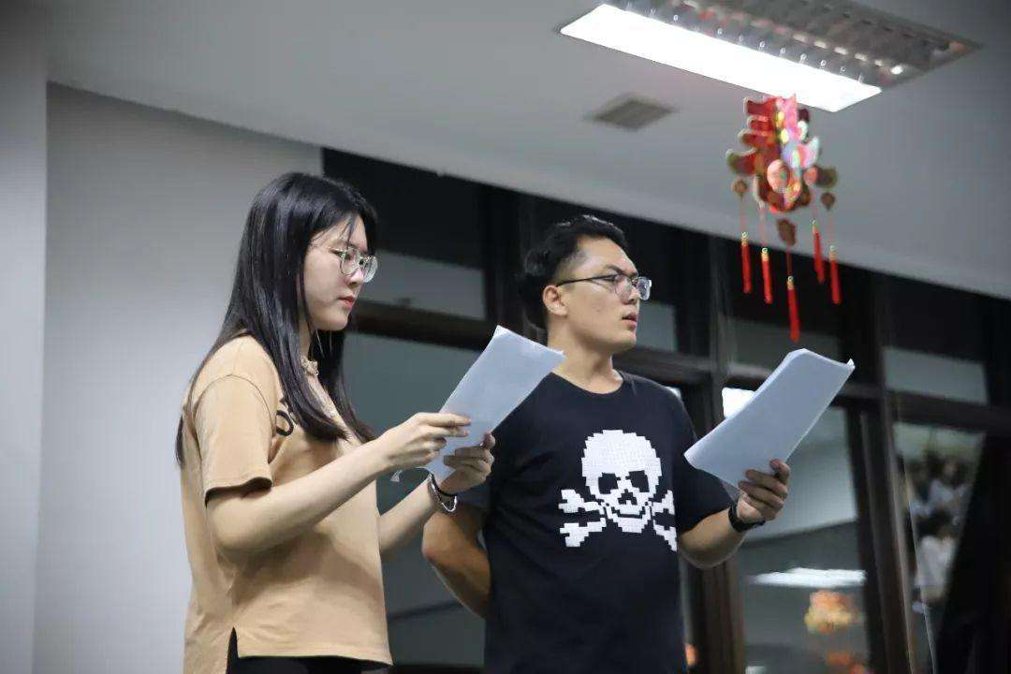
Role-play the conversation.
Hi, Claire, …
Hmm, ...

Slide 58
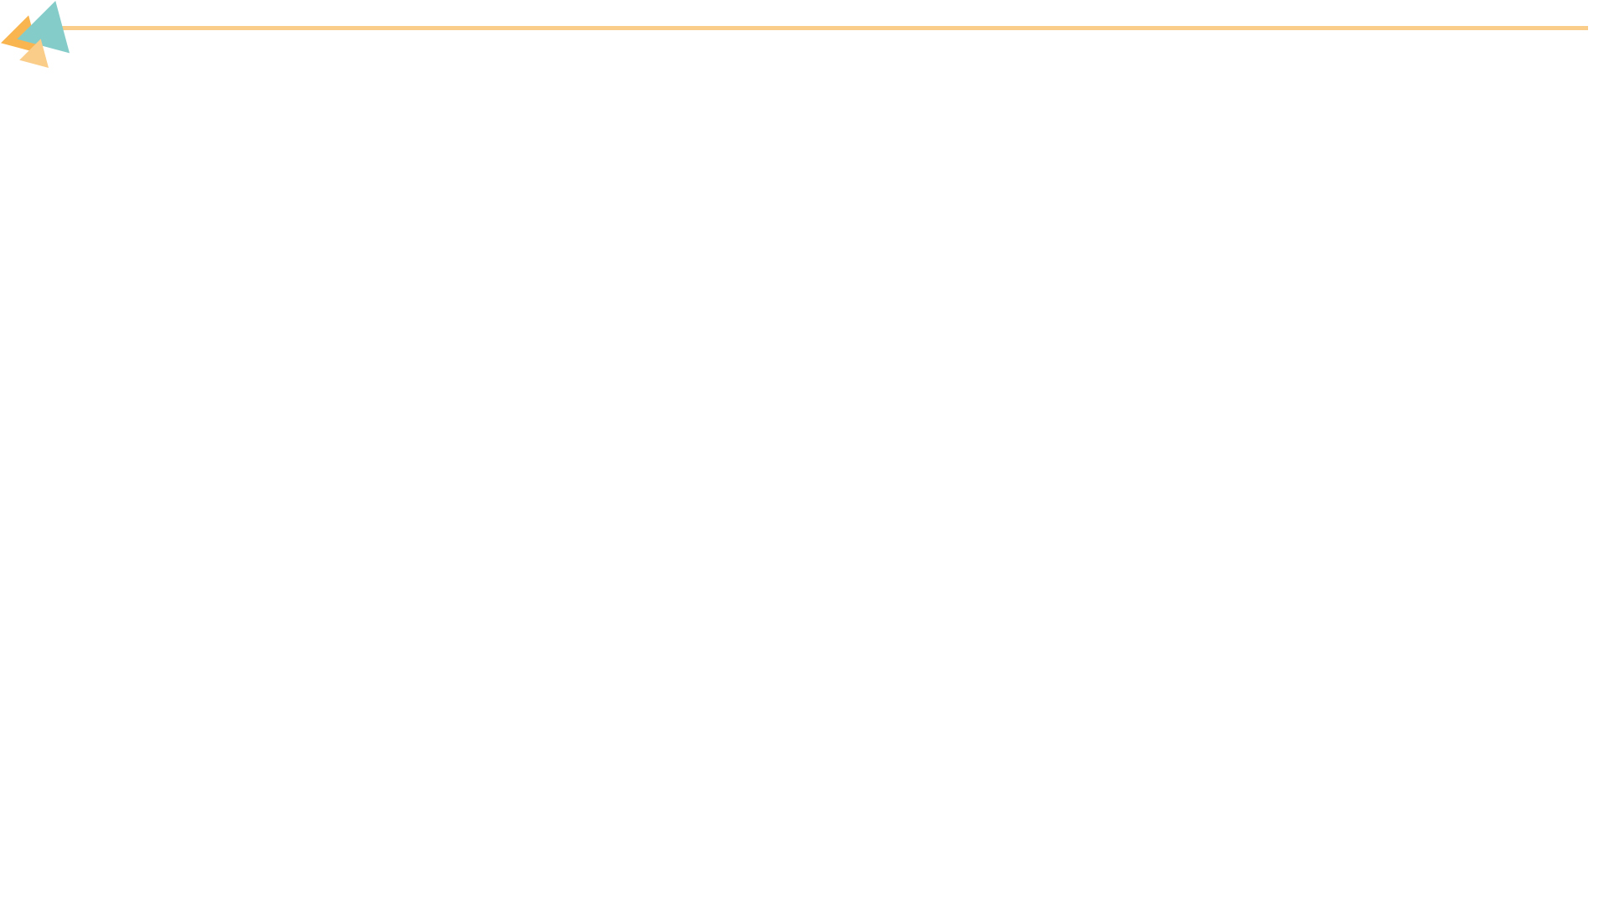

Ⅰ. 根据句意，从方框中选择恰当的单词填空，注意形式变化。
program, once, housework, full, swing
1. My mother asks me to watch English movies and TV __________.
2. Do you often help your parents do __________ at home?
3. The restaurant is _______. We have to go to another one.
4. Jane’s arms (手臂) _______ when she walked.
5. Mr. Smith washes his car _______ a week.
programs
housework
full
swung
once

Slide 59
Ⅱ. 根据汉语意思，完成英语句子，每空一词。
1. 你怎么回来这么早？
_______ _______ you got back so early?
2. Tina每周六上钢琴课。
Tina _________ _______ _______ every Saturday.
3. 我们需要使用互联网做作业。
We need to _______ _______ ________ to do our homework.
4. 她一个月看两次电影。
She goes to the cinema _______ _______ _______.
5. Jack晚上几乎从不外出。
Jack _______ _______ goes out at night.
How come
has/takes piano lessons
use the Internet
twice a month
hardly ever

Slide 60
Ⅲ. 根据对话内容，从方框中选择恰当的选项补全对话，其中有两项多余。
A: John, I feel bored today.
B: I have an idea. (1)_______
A: Oh, no, not baseball.
B: Why, Lee?
C: He doesn’t like baseball at all.
B: Really? (2)_______
A: I like basketball best. I think it’s fun and exciting.
A. That’s great.
B. Do you exercise?
C. Let’s meet at 5:00.
D. What about you, Bill?
E. How do you feel like basketball?
F. Let’s play baseball after school.
G. What kind of sports do you like?
F
G

Slide 61
A. That’s great.
B. Do you exercise?
C. Let’s meet at 5:00.
D. What about you, Bill?
E. How do you feel like basketball?
F. Let’s play baseball after school.
G. What kind of sports do you like?
B: Yeah, sometimes I play basketball, too. (3)_______
C: I play basketball every afternoon and I’m a great basketball player.
B: (4)_______ Come on, can we join you today?
C: Sure. (5)_______
A&B: OK, see you!
D
A
C

Slide 62


Recite the conversation of 2d.
Preview the Grammar Focus.

